Slide 1

A Study on Variants of Deep Q-Learning Algorithm
Presentation by
Vikrant Kalidas Wadhavankar
Sayali Mahajan
Gaurav Jha
Deepesh Ahuja
Amit Ojha
Mentored by
Prof. Ambedkar Dukkipati

Slide 2
Agenda
Algorithms
  DQN, Double DQN, Dueling DQN
Environments
  Cartpole-v1, LunarLander-v3, RecGym
Implementation
  Code
  Resource Footprints
  GitHub (Code, GitAction, Workflow) & Streamlit (App hosting, Dashboard)
Inferences
  Result Summary, Graph, Inferences
References
Q&A

Slide 3
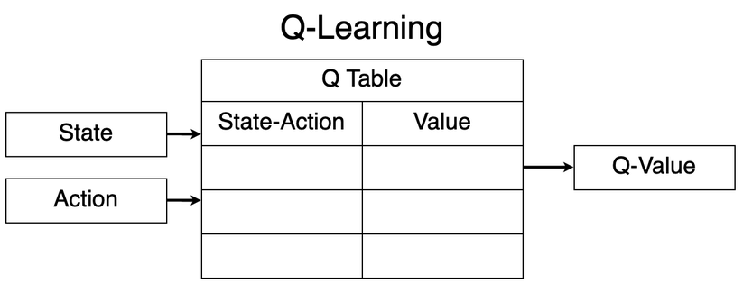
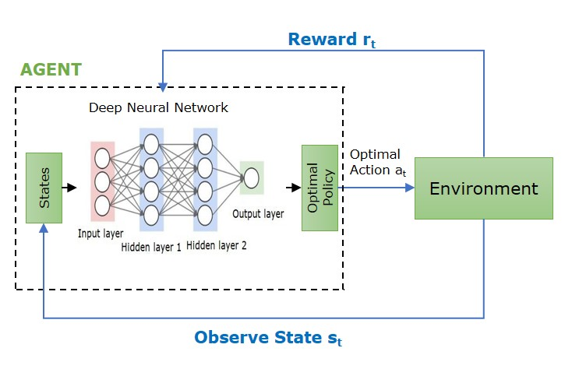
Deep Q-Learning
Q-learning - Limitation
Can't handle very Large state space (viz images, physics simulations, robotics).
Impossible to store (millions of combinations) in Q-tables
Real-world tasks require function approximation, not lookup tables.
Deep Q-Learning (DQL)
Extends traditional Q-learning using Deep Neural Network
to estimate the Q-value function
Handles large environments with continuous state spaces
Learning nonlinear patterns from raw observations.
Scalable, generalizable, and practical.

Slide 4
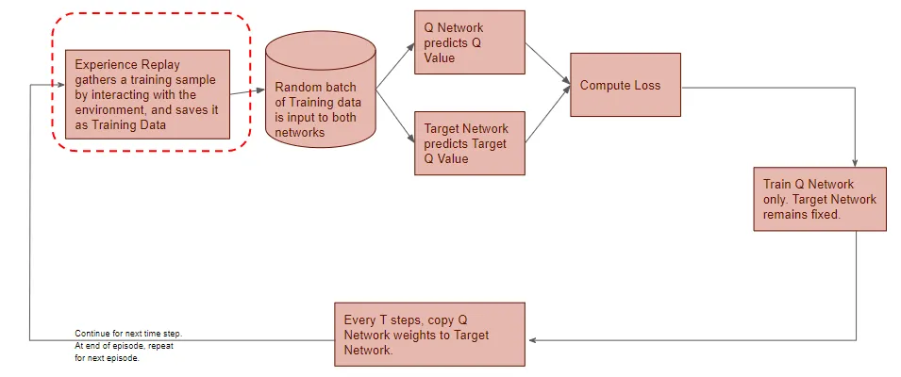
Double Deep Q-Network Learning Process

Slide 5
Variants of DQN Algorithm
DQN (Deep Q-Network)
• Uses one network to select & evaluate actions
• Overestimates Q-values
• Q(s,a) = r + γ max Q(s’, a’)
DDQN (Double DQN)
• Uses two networks:
– Main selects action
– Target evaluates selected action
• Fixes overestimation bias
• Q(s,a) = r + γ Q_target(s’, argmax Q_main(s’, a’))
Dueling DQN
• New architecture with two streams:
– Value V(s)
– Advantage A(s,a)
• Q(s,a) = V(s) + (A(s,a) – mean(A))
• Better for states where actions don’t matter
Feature | DQN | DDQN | Dueling
Overestimation | High | Low | Very Low*
Architecture | Normal | Normal | Value + Advantage
Stability | ⭐ | ⭐⭐ | ⭐⭐⭐
Action Selection | Same Network | Main Network | Same as DQN/DDQN
Action Evaluation | Same Network | Target Network | Value + Advantage

Slide 6
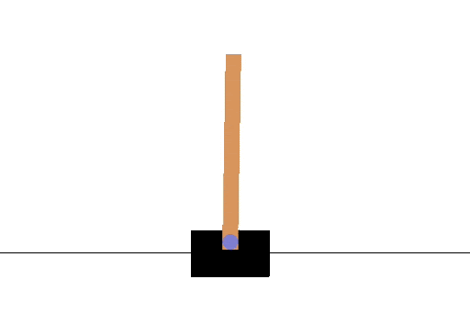
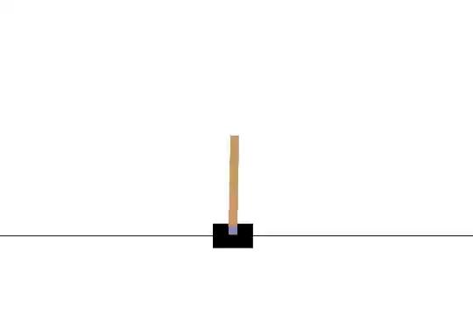
ENVIRONMENT - CartPole -v1
CartPole Overview
Fully observable 4-dim continuous state (position, velocity, angle, angular velocity)
Discrete actions: push Left / Right
Reward: +1 per timestep balanced
Episode ends if pole falls or cart exits bounds
Serves as the canonical sanity-check environment for value-based RL.
Action Space - 0: Push cart to the left 1: Push cart to the right
Observation Space - Box([-4.8 -inf -0.41887903 -inf], [4.8 inf 0.41887903 inf], (4,), float32)
Why CartPole for DQN Family?
Perfect diagnostic sandbox for Q-learning stability
Small state space → highlights overestimation bias
Fast training → reveals differences between DQN / DDQN / Dueling
Discrete actions → ideal match for value-based methods

Slide 7
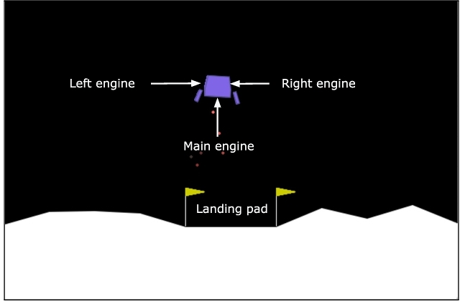
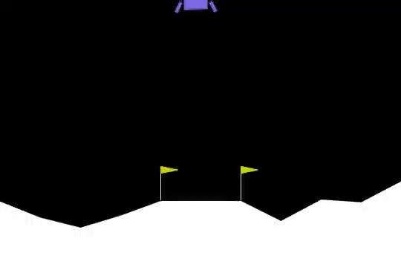
ENVIRONMENT - LunarLander-v3
Overview - A physics-based task where a lander must descend, stabilize, and touch down between flags.
State & Actions
State (8D): position, velocity, angle, angular velocity, leg contacts
Actions: idle (0), left (1), main (2), right (3) thruster
Dynamics & Rewards
Gravity −10 m/s², realistic thrust
+100–140 for soft landing, −100 for crash
Shaping for stability, orientation, leg contact
Small penalties for thrust usage
Why It Fits DQN / DDQN / Dueling
Discrete actions suit value-based RL
Non-linear physics reveals Q-overestimation → DDQN helps
Reward shaping + long-horizon control benefit Dueling/N-step/PER approaches

Slide 8
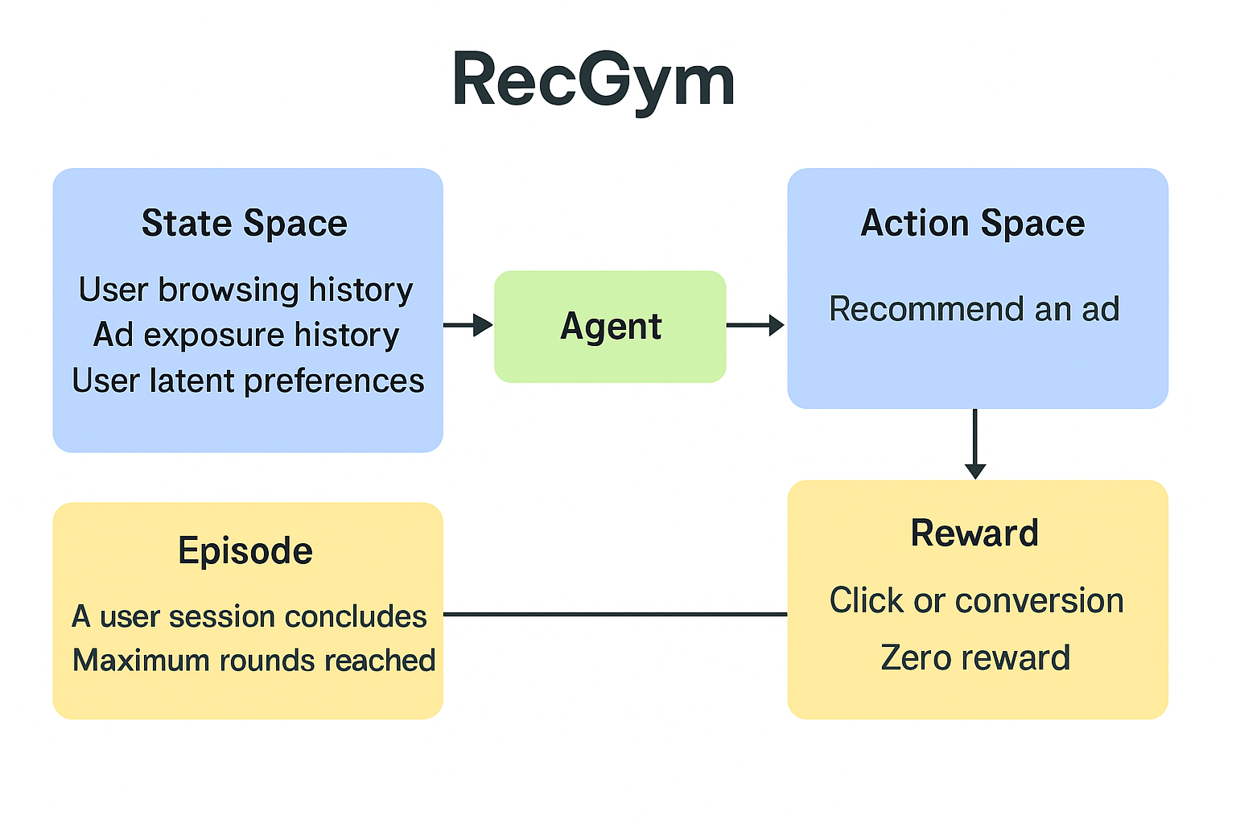
ENVIRONMENT - RecGym
RecGym Overview
Simulator for recommender interactions with evolving synthetic users.
Preferences shift over time; agent sees only clicks/skips/dwell.
Noisy, partially observable, non-stationary setting.
Supports single-item and slate actions.
Why RecGym for DQN / DDQN
Discrete actions suit Q-learning.
Sparse, delayed rewards reflect real recommenders.
DQN overestimates under noisy signals.
DDQN stabilizes by separating selection and evaluation.
Clearly exposes robustness differences.
Key Outputs
Episode Reward: Session-level engagement.
Epsilon: Exploration rate.
Reward Curve: Adaptation to preference shifts.

Slide 9
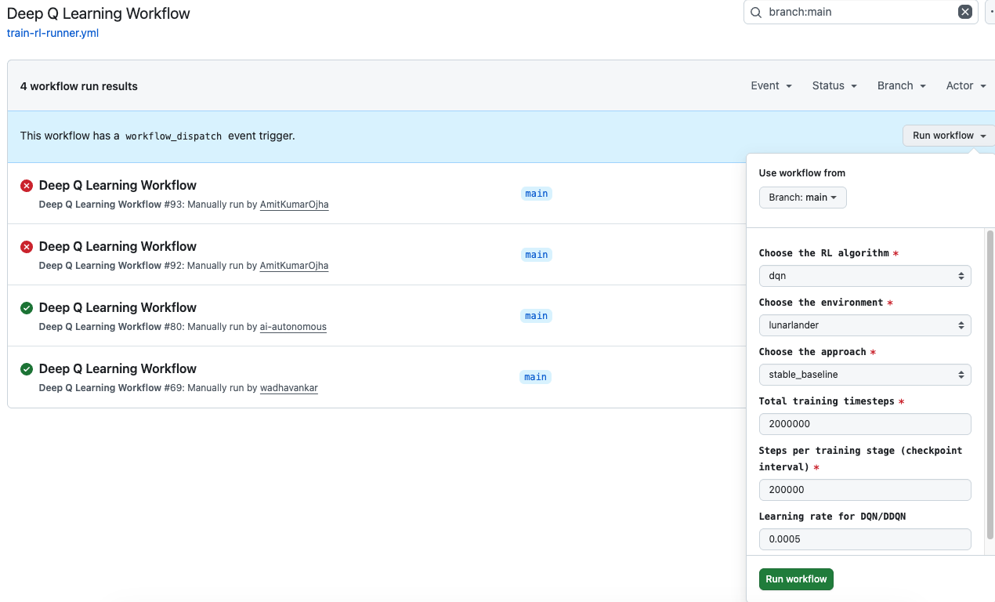
Implementation – Deep RL Automation Pipeline
Pipeline Features
Workflow
Automate Deep Reinforcement Learning training using GitHub Actions
Supports
🎯 Algorithms: DQN, DDQN, Dueling-DQN
🌍 Environments: LunarLander, CartPole, RecGym
🧠 Approaches: Stable-Baselines3, Keras
🔽 Outcome Outputs
Model checkpoints in models/
Training video (best episode)
Reward/Loss plots
Evaluation summary
Execute Workflow

Slide 10

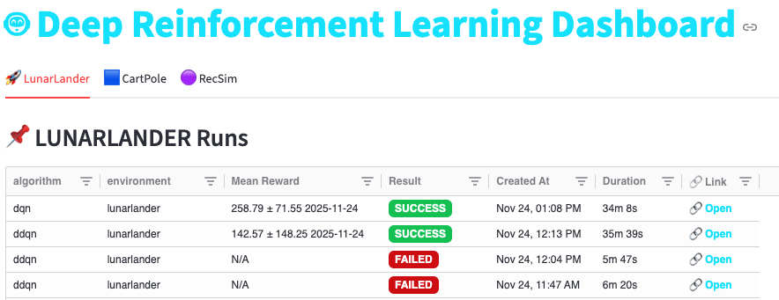
Implementation: 🤖 Deep Reinforcement Learning Dashboard
Github Repo
https://github.com/ai-autonomous/dqn-project
💡 Dashboard Benefits
Central place to review runs
Quickly jump to logs & artifacts on GitHub Actions
No need to open GitHub manually each time
Simple monitoring for multiple experiments by multiple users
🖥 Dashboard - Live monitoring app:
🔗 https://ai-autonomous.streamlit.app
📌 Purpose - Track Deep Q-Learning experiment runs triggered via GitHub Actions.

Slide 11
RESULT SUMMARY - Training
Env Name | Approach Name | Algo Name | Setup Details | Total Steps | Stage size | Loss | Rewards
LunarLander-v3 | Stable Baseline | DQN | Mem: 15Gi Model Name: AMD EPYC 7763 64-Core Processor CPU(s): 4 | 30L 20L | 1L 2L | 0.7094 0.1650 | 258.79 ± 71.55 262.91 ± 50.10
 | Keras | DDQN | Mem : 16 GB Model : AMD Ryzen 7 5800HS Radeon Graphics (3.20GHz) | 5L 4L | 50k 50k | 1.2109 1.1300 | 227.84 +/- 3.08 251.17 +/- 0.95
 | Keras | Dueling Network | Mem : 16 GB Model : AMD Ryzen 7 5800HS Radeon Graphics (3.20GHz) | 1.5L 3L | 50k 50k | 0.6488 0.5950 | 222.22 +/- 9.45 230.50 +/- 0.8
CartPole-v1 | Stable Baseline | DQN | Mem: 15Gi Model Name: AMD EPYC 7763 64-Core Processor CPU(s): 4 | 50k 70k | 10k 5k | 0.0085 0.0140 | 265.00 ± 13.10 343.80 ± 7.57
 | Keras | DDQN | Mem: 2.9 GB System RAM + 0.4 GB GPU RAM Model Name: Nvidia A100 GPUs: 1 | 1L | 10k | 0.8734 | 277.10 ± 51.56
 | Keras | Dueling Network | Mem: 3.8 GB System RAM + 0.6 GB GPU RAM Model Name: Nvidia A100 GPUs: 1 | 1L | 10k | 0.5724 | 224.05 ± 28.25
RecGym | Stable Baseline | DQN | Mem : 16 GB Model : Apple M4 , 10 core Processor. | 30K | 10k | -NA- | –1.4 to +2.8

Slide 12
RESULT SUMMARY - Evaluation
Env Name | Approach Name | Algo Name | Steps | SOLVED | GOOD RUN | FAIL | TIME LIMIT
CartPole-v1 | Stable Baseline | DQN | 50k 70k | 0 0 | 20 20 | 0 0 | 0 0
 | Keras | DDQN | 10k | 0 | 19 | 1 | 0
 | Keras | Dueling Network | 10k | 0 | 19 | 1 | 0
SOLVED – (truncated == True and steps == max_steps) | GOOD_RUN – (terminated == True and steps ≥ 195) | TIME_LIMIT – (truncated == True and steps < max_steps) | FAIL – (terminated == True and steps < 195) | UNKNOWN – (anything else)
Env Name | Approach Name | Algo Name | Steps | LANDED_OK | CRASH | ASLEEP | OUT_OF_BOUNDS
LunarLander-v3 | Stable Baseline | DQN | 30L total/ 1L stage = 30 20L total/ 2L stage = 20 | 19 15 | 1 2 | 0 3 | 0 0
 | Keras | DDQN | 50L total 40L total | 20 0 | 0 0 | 0 0 | 0 20
 | Keras | Dueling Network | 1.5L total 40L total | 20 20 | 0 0 | 0 0 | 0 0
LANDED_OK - (Left = 1 and Right = 1) | CRASH - (Game_over) | OUT_OF_BOUND - (X_POS >= 2.5) | ASLEEP - (Left != 1 or Right != 1)

Slide 13
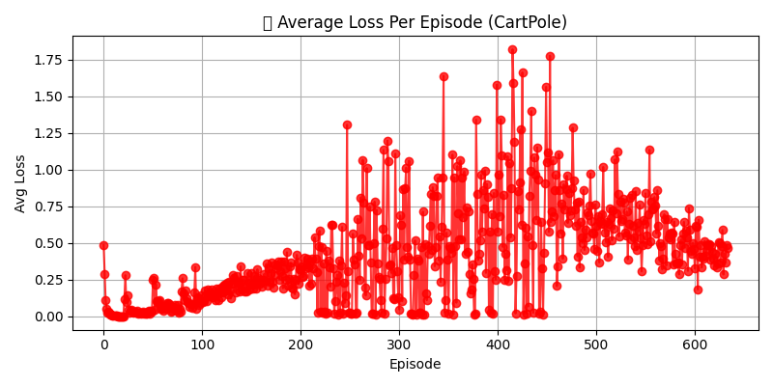
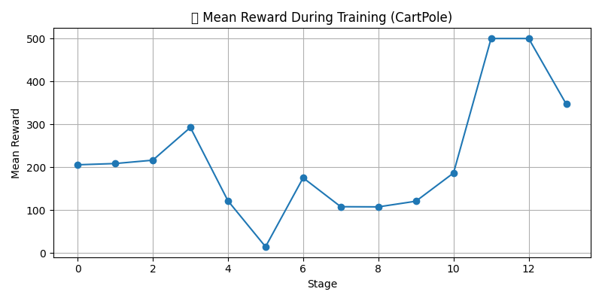
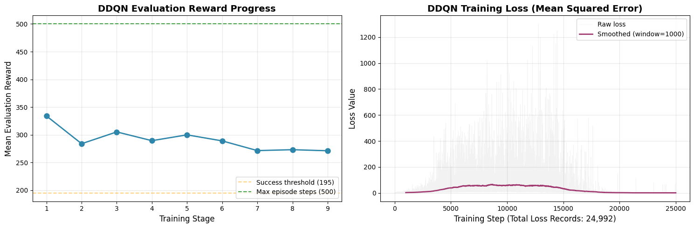
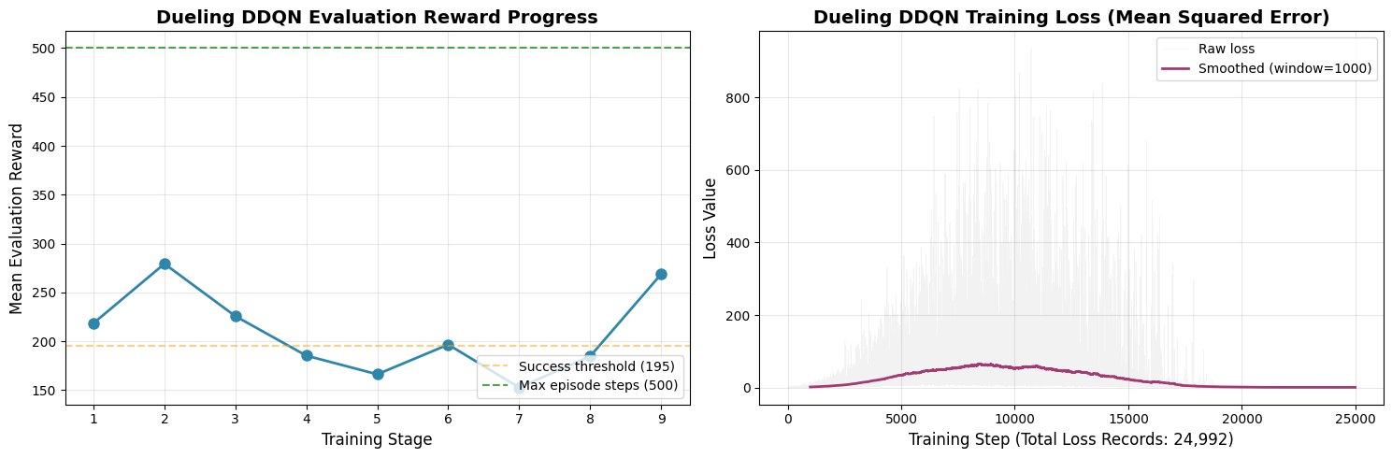
RESULT SUMMARY - Cartpole-v1
DQN
DDQN
Dueling
DQN

Slide 14
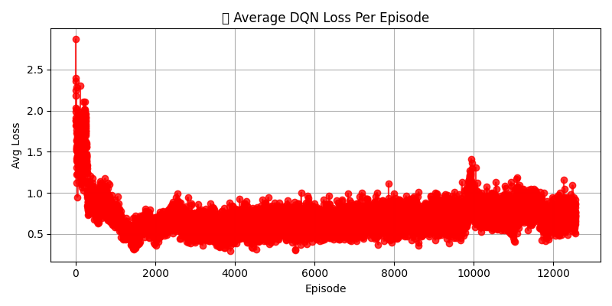
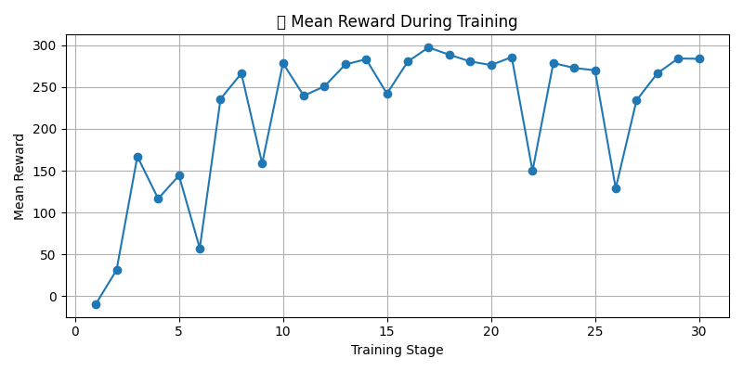
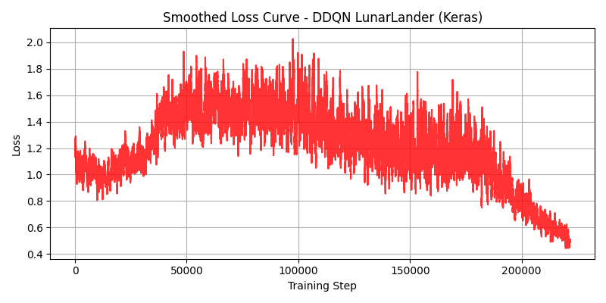
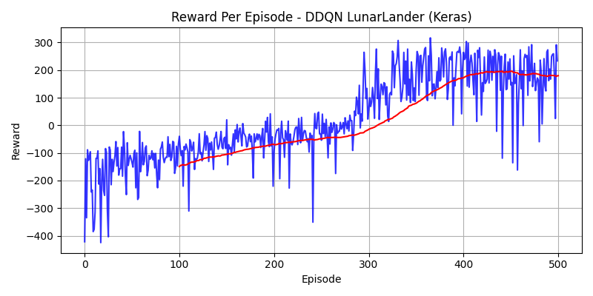
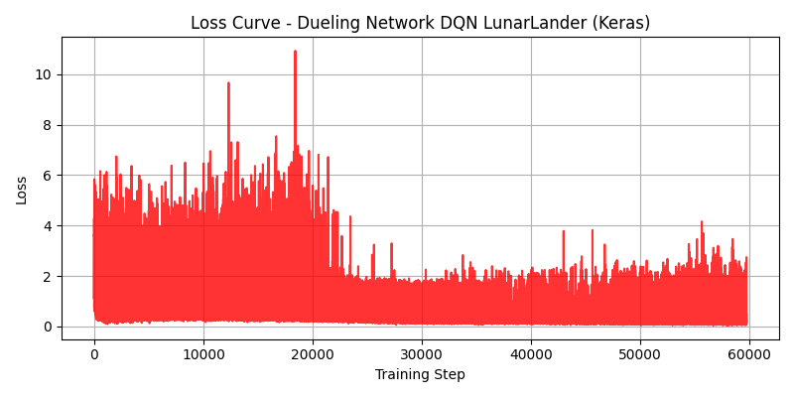
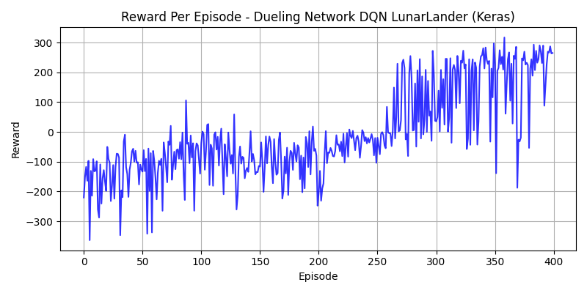
RESULT SUMMARY - LunarLander-v3
DQN
DDQN
Dueling
DQN

Slide 15
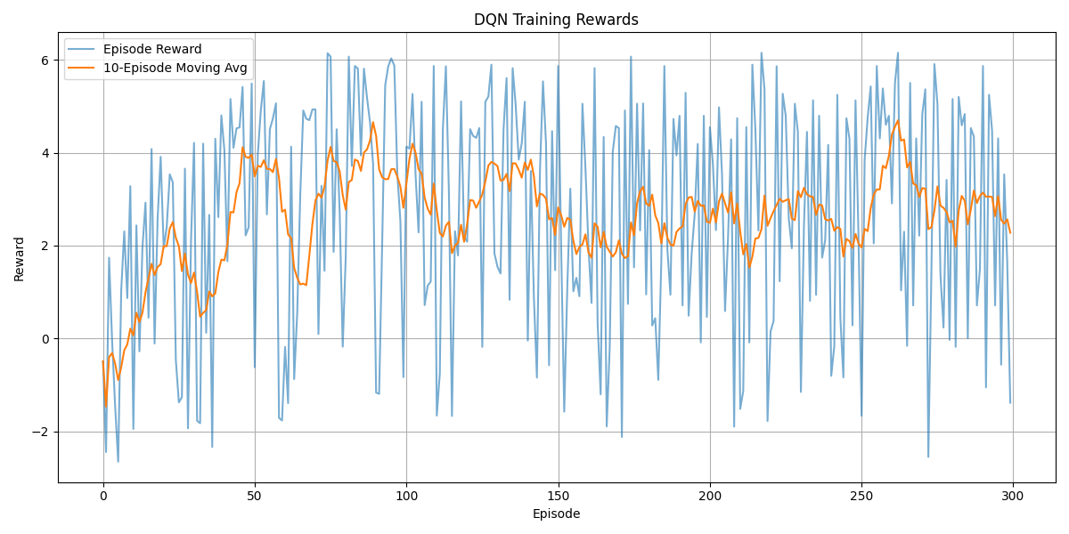
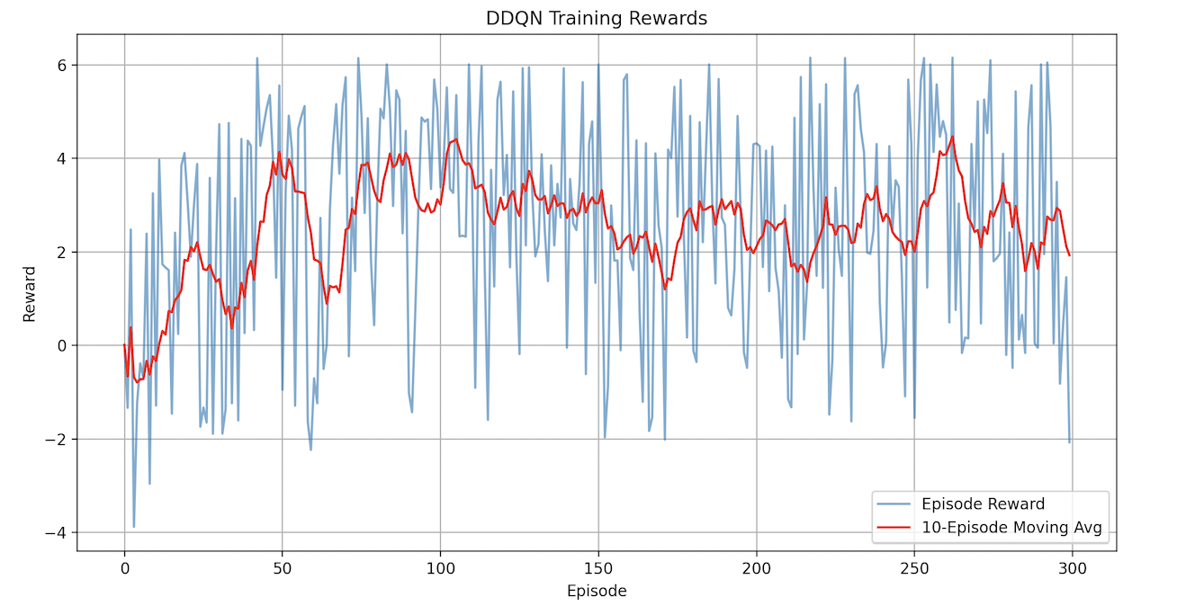
RESULT SUMMARY - RecGym
DQN
DDQN

Slide 16
Project
Code - https://github.com/ai-autonomous/dqn-project
Dashboard - https://ai-autonomous.streamlit.app/
GitAction - https://github.com/ai-autonomous/dqn-project/actions
Workflow - https://github.com/ai-autonomous/dqn-project/blob/main/.github/workflows/train-rl-runner.yml
External
https://docs.pytorch.org/tutorials/intermediate/reinforcement_q_learning.html
https://stable-baselines3.readthedocs.io/en/master/modules/dqn.html#module-stable_baselines3.dqn
https://arxiv.org/abs/1509.06461
https://gymnasium.farama.org/environments/classic_control/cart_pole/
https://gymnasium.farama.org/environments/box2d/lunar_lander/
https://github.com/hakuhodo-technologies/scope-rl
https://arxiv.org/abs/1101.2883

Slide 17



